Slide 1

– your IT Inkyubator for Ideas that grow
Inkyubeta
We transform visions in successful startups
Address: Markus Ganzmann GmbH, Sonnenhalde 21, 71144 Steinenbronn
Contact: Phone: +49 7157 813998 – 0, E-Mail: adm@inkyubeta.de
11/2025

Slide 2

Why do so many tech ideas never scale?
Many tech ideas fail — not because they lack vision, but because founders struggle to turn ideas into scalable businesses.
Early-stage ventures often lack strategic leadership and technical execution power.
Founders need access to the right mentors, investors, and networks to reach the market.
The fast-moving IT sector demands rapid validation and scaling — few can do this alone.

Slide 3



From Vision to Scalable IT Venture
We turn IT ideas into successful businesses — with leadership, mentoring & smart capital.
Strategic Mentoring
C-level Leadership
Partnerships & Network
We guide founders through validation, product strategy, and growth — providing practical, hands-on support from day one.
We step in as experienced CTOs, COOs or advisors to bridge leadership gaps and accelerate technical and operational execution.
We connect startups with experts, partners, and resources that empower them to scale effectively — without focusing on capital.

Slide 4

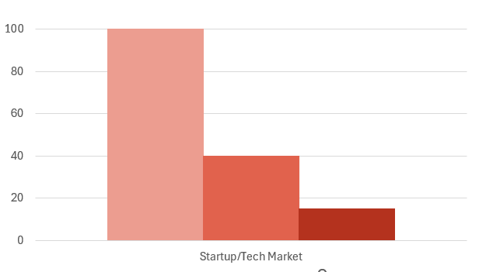

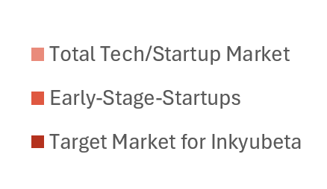

Target Market & Segmentation
Focusing on Early-Stage IT & Tech Founders
Idea Stage
Founders with an initial concept or prototype — seeking validation and early technical guidance.
Early Stage
Startups with a first product or pilot users — ready to scale but lacking structure and leadership.
Scale Stage
Growing ventures aiming to expand teams, processes, and markets — seeking sustainable growth support.

Slide 5



How Inkyubeta Generates Sustainable Value
Our business model combines equity participation, strategic co-building, and long-term partnerships — aligning our growth with the success of our startups.
Equity Participation
Venture Services
Partnership Network
We invest time, expertise, and leadership in exchange for minority shares in the startups we co-build.
→ Shared success, shared growth.
We provide tailored strategic and technical support (interim C-level, product strategy, operations) on a project-based model.
→ Revenue from high-value expertise.
We work with investors and tech partners to co-create ventures — driving innovation and long-term growth.
→ Sustainable pipeline for future ventures.

Slide 6

Proven Impact and Growing Network
Professional, reliable, and partnership-oriented — our ventures
grow through collaboration, experience, and trust.
Supported multiple IT ventures from concept to market launch
Built a strong ecosystem of mentors, partners, and experts
Trusted by founders for our hands-on, results-driven approach
“Our results speak through the
success of our startups.”

Slide 7




Standing Out in a Crowded Market
The startup ecosystem is filled with incubators and accelerators — but few combine deep IT expertise with hands-on leadership and long-term partnership.
Tech-Focused DNA
Hands-On C-Level Leadership
We specialize exclusively in IT and tech ventures — combining technical depth with business acumen.
Unlike traditional incubators, we actively take interim C-level roles to drive real execution, not just advice.
Mentorship Meets Partnership
Decades of Proven Experience
We work side by side with founders — blending mentoring, strategic guidance, and network access.
Over 20 years in the IT sector — transforming complex technologies into scalable business success.

Slide 8
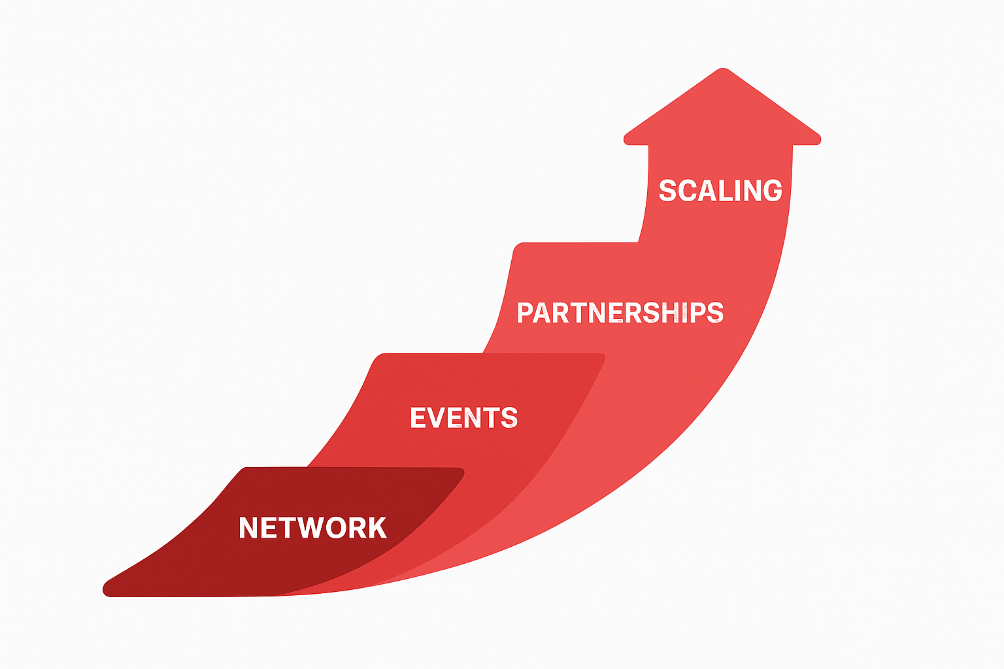
Expanding Through Network, Expertise & Focus
Inkyubeta grows by connecting people, ideas, and opportunities — leveraging our ecosystem of experts, partners, and innovators.
Strategic Network Expansion
We source promising startups through our established IT and tech ecosystem.
Events & Thought Leadership
Initiatives like the AI Innovation Breakfast strengthen our brand visibility and attract new founders.
Partnerships & Collaborations
We build alliances with investors, corporate innovation teams, and technology partners.
Thematic Scaling
Focused growth in high-impact fields such as AI, Automation, and Cybersecurity across the DACH region.

Slide 9



Beyond Investment - Partnership
We don’t just invest in startups — we believe in the people behind them.
Our goal is to create long-term value through smart collaboration and shared success.
What we are looking for:
Innovative Founders & Ideas
Partnerships & Co-Investors
Growth Capital
Funds to scale our incubation capacity, expand our reach in AI and IT security, and strengthen our partner ecosystem.
Early-stage IT and tech concepts seeking strategic and technical co-building support.
Strategic partners, tech enablers, and investors who share our vision of sustainable venture building.

Slide 10
Build. Innovate. Grow. Together.
Our long-term mission is to empower founders to turn bold tech ideas into successful, scalable ventures — together with the right partners, leadership, and vision.
Let’s build something great together.
If you have an idea, a prototype, or need support to scale — let’s connect.
Address: Markus Ganzmann GmbH, Sonnenhalde 21, 71144 Steinenbronn
Contact: Phone: +49 7157 813998 – 0, E-Mail: adm@inkyubeta.de

